Slide 1

Lecture 2
Data Mining Basics

Slide 2

Discuss a framework for Knowledge Discovery
Examine some evaluation Methods for Classification
Discuss methods for pre-processing data

Slide 3

Data Mining is part of a larger iterative process of Knowledge Discovery
The steps in the Knowledge Discovery process are:
  Defining the problem – identify the goals of your KD project
  Data Collection – will involve cleaning and pre-processing the data
  Data Mining – the model building step
  Validating the model – will usually involve some type of Statistical Analysis
  Deploying the model
  Monitoring the model – model requires periodic re-evaluation on new data to assess if it is still appropriate

Slide 4

What are the problems with the raw data set below?
Customer ID | Zip Code | Gender | Salary | Age | Marital Status | Trans. Amount
1001 | 10048 | M | 75,000 | C | M | 5,000
1002 | J2S7K7 | F | -40,000 | 40 | W | 3,000
1003 | 90210 |  | 10,000,000 | 45 | S | 6,000
1004 | 6269 | M | 50,000 | 0 | S | 5,000
1005 | 55101 | F | 99,999 | 30 | D | 10,000

Slide 5

id | mpg | cylinders | cubic inches | hp
1 | 14 | 8 | 350 | 165
2 | 31.9 | 4 | 89 | 71
3 | 51.7 | 8 | 302 | 140
4 | 15 |  | 400 | 150
5 | 30.5
6 | 23 |  | 350 | 125
7 | 13 |  | 351 | 158
8 | 14 | 8 |  | 215
9 | 25.4 | 5 |  | 77
10 | 37.7 | 4 | 89 | 62

Slide 6
id | mpg | cylinders | cubic inches | hp
1 | 14 | 8 | 350 | 165
2 | 31.9 | 4 | 89 | 71
3 | 51.7 | 8 | 302 | 140
4 | 15 | 6 | 400 | 150
5 | 30.5 | 6 | 200.65 | 106.53
6 | 23 | 6 | 350 | 125
7 | 13 | 6 | 351 | 158
8 | 14 | 8 | 200.65 | 215
9 | 25.4 | 5 | 200.65 | 77
10 | 37.7 | 4 | 89 | 62
Replace missing values with mean values

Slide 7

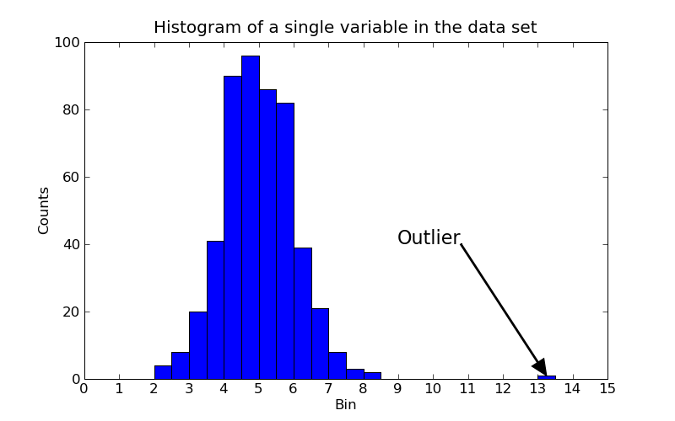
Extreme values close to the limits of the data range or do not follow the trend of the remaining data
May represent errors occurred during data acquisition
May have a negative impact on the data mining method

Slide 8

Problem:
The ranges of certain variables may differ greatly from each other which can have a negative effect on the data mining technique. Variables with greater ranges have stronger impact on the results than others.
id | mpg | cylinders | cubic inches | hp
1 | 14 | 8 | 350 | 165
2 | 31.9 | 4 | 89 | 71
3 | 51.7 | 8 | 302 | 140
4 | 15 | 8 | 400 | 150
5 | 30.5 | 4 | 144 | 116.55
6 | 23 | 4 | 350 | 125

Slide 9
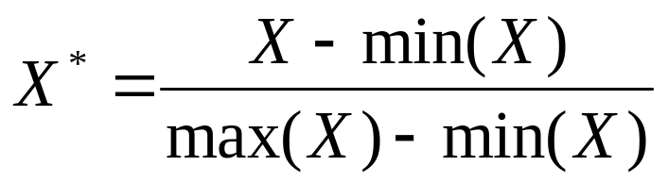
Solution:
Normalize the data to standardize the scale of each variable.
Example:
Min-Max Normalization
id | mpg* | cylinders* | cubic inches* | hp*
1 | 0 | 1 | 0.84 | 1
2 | 0.47 | 0 | 0 | 0
3 | 1 | 1 | 0.68 | 0.73
4 | 0.03 | 1 | 1 | 0.84
5 | 0.44 | 0 | 0.18 | 0.48
6 | 0.24 | 0 | 0.84 | 0.57

Slide 10

Motivation: Removal of redundant attributes has the following advantages:
Results in a smaller, and more understandable model
Reduces the amount of time spent in model building – increases efficiency
An improvement in classification accuracy

Slide 11

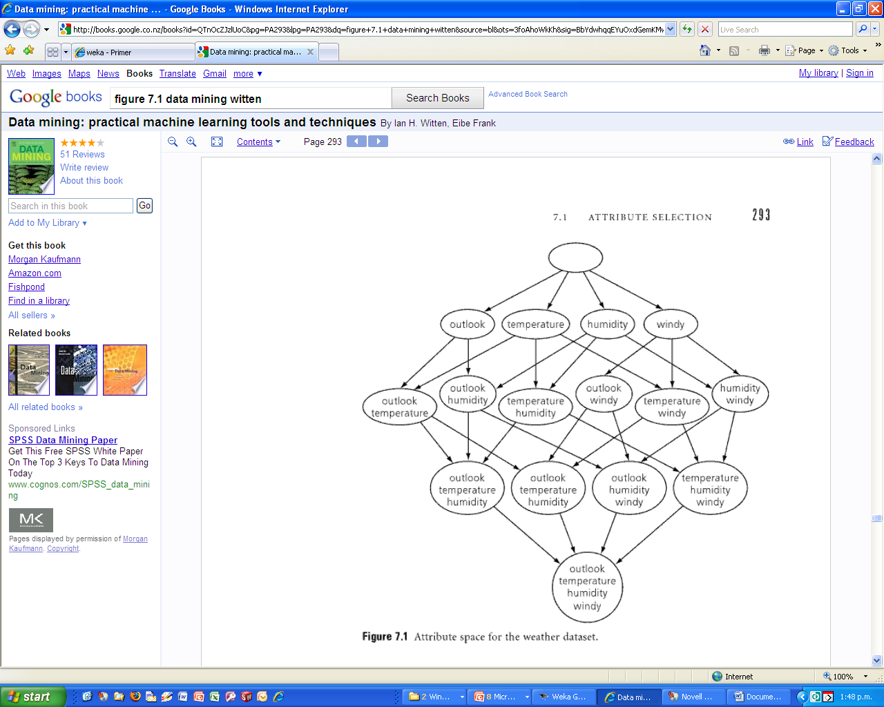
In general there are two different approaches:
Forward selection
Backward Elimination

Slide 12

In forward selection we start with an empty set A of attributes
At each step an attribute is added and a performance measure is evaluated (for example Correlation or Information Gain)
The attribute that produces the best performance is added to set A.
We now add each of the remaining attributes to set A and note the attribute with the highest Information Gain (Correlation).
This attribute is now added to set A.
The entire process is repeated until no more attributes can be added to set A – i.e. at a particular round (iteration) all attributes when added decrease, rather than increase the Information Gain (Correlation).
The set A at the end of the process contains the set of non redundant attributes

Slide 13

Similar to forward selection but the set A initially consists of the full set of attributes.
At each step we eliminate (rather than add) the attribute that leads to the highest Information Gain.
The process is repeated at the iteration when every attribute that remains in set A leads to a loss of Information Gain.
The attributes that remain in set A contain the list of non redundant attributes.

Slide 14

In Weka attribute selection is performed through the use of the Attribute Selection tab in the Weka Explorer module.

Slide 15

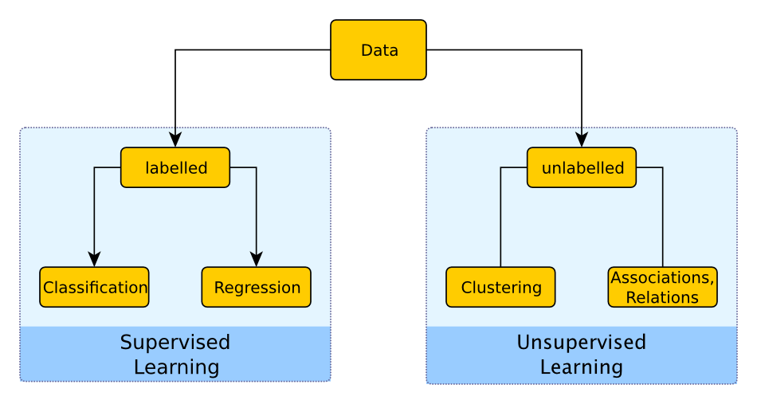

Slide 16

Example problems: weather data, contact lenses, irises, labor negotiations
Classification learning is supervised
Scheme is being provided with actual outcome
Outcome is called the class of the example
Success can be measured on fresh data for which class labels are known ( test data)

Slide 17

The confusion matrix is a good summary of a classifier’s performance
Computed Computed
Accept Reject
Accept True False
Accept Reject
-----------------------------------------------------------
Reject False True
Accept Reject

Slide 18

The matrix provides us with a good basis for comparing classifiers
For example, Models A and B represent two different classifiers for the credit card application problem
Which model is better, A or B ?
Model Computed Computed Model Computed Computed
A Accept Reject B Accept Reject
Accept 600 25 Accept 600 75
Reject 75 300 Reject 25 300

Slide 19
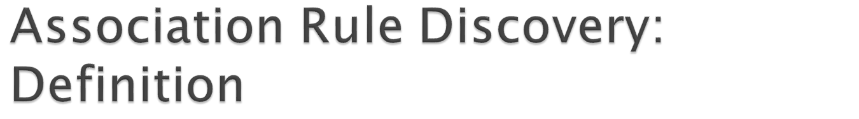

Given a set of records each of which contain some number of items from a given collection;
  Produce dependency rules which will predict occurrence of an item based on occurrences of other items.
Rules Discovered:
{Milk} --> {Coke}
{Diaper, Milk} --> {Beer}

Slide 20

Marketing and Sales Promotion:
  Let the rule discovered be
  {Bagels, … } --> {Potato Chips}
  Potato Chips as consequent => Can be used to determine what should be done to boost its sales.
  Bagels in the antecedent => Can be used to see which products would be affected if the store discontinues selling bagels.
  Bagels in antecedent and Potato chips in consequent => Can be used to see what products should be sold with Bagels to promote sale of Potato chips!

Slide 21

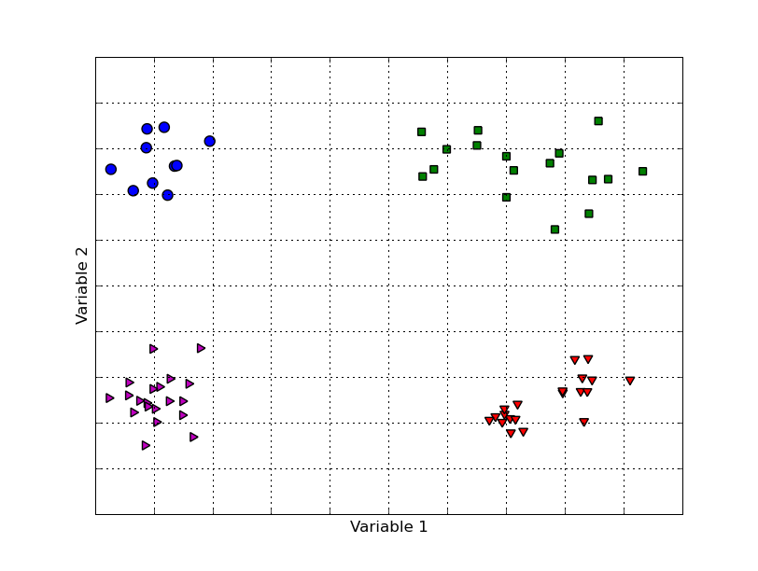

Slide 22

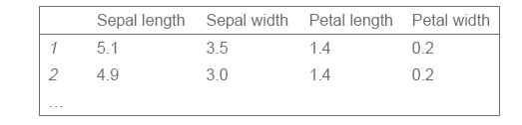
Finding groups of items that are similar
Clustering is unsupervised
The class of an example is not known
Success of clustering often measured subjectively
Example problem: iris data without class

Slide 23
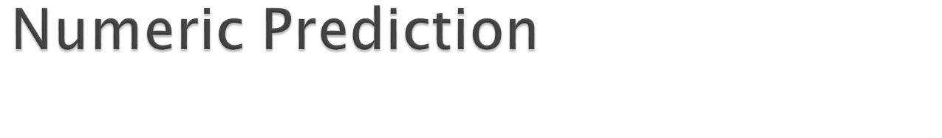
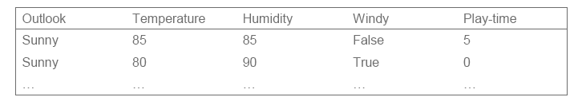
Like classification learning but with numeric “class”
Learning is supervised
Scheme is being provided with target value
Success is measured on test data
Example: modified version of weather data

Slide 24

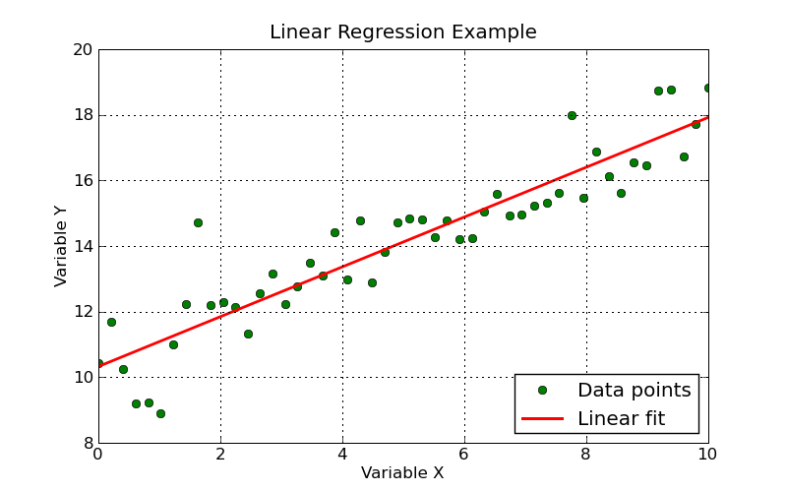
Models the relationship between variable Y and variable X using a linear fit: Y = a X + b
Determines the best straight line through the given data

